Slide 1
TCP/IP

Slide 2
Like OSI model
Developed by DARPA
Seen as less ridged than the OSI model
More tuned to modern protocol

Slide 3
TCP
Application
Application
Presentation
Session
Transport
Transport
Network
Internet layer
Data Link
Network
access
layer
Physical
Notes:
TCP Transmission Control Protocol

Slide 4
Application
Provides standardized data exchange
Supports protocols like:
HTTP
FTP
POP3
Smtp
Snmp
This is the part we will use
Notes:
http Hyper text transfer protocol
FTP file transfer protocol
Pop3 post office protocol 3
Smtp simple mail transfer protocol
Snmp simple network Management protocol

Slide 5
Transport
Responsible for message segmentation
Acknowledgements
Traffic control
Error detection and correction
Common protocols Transport Control Protocol (TCP) and User Datagram Protocol (UDP).

Slide 6
Internet layer
Some time called Network layer
Deal with packets and connects independent networks
Uses Internet protocol and Internet Control Message Protocol

Slide 7
Network Access Layer
Consists of protocols that operate only on a link (i.e. the connection between nodes)
Think routers and switches.

Slide 8
Notice that I’m talking about TCP/IP and TCP as separate things.
This is because TCP and IP are 2 separate collections protocols
They usually come together and are called the TCP/IP suite.

Slide 9
IP
Runs on the internet/ network layer
Is responsible for relaying datagrams across network boundaries (internetworking, makes the internet work).
Responsible for delivering IP packets (not the same a TCP/UDP packets).
Segments TCP/UDP data (is required) in to smaller packets and adds its header to the packet
Data is segmented if the original data exceeds the MTU (Maximum Transmission Unit) of the network (usually around 1500 byte for ethernet)
IP is connectionless
We rely on TCP to maintain ordered, reliable data, making it connection orientated over connectionless communication.
Notes:
IP Internet Protocol

Slide 10
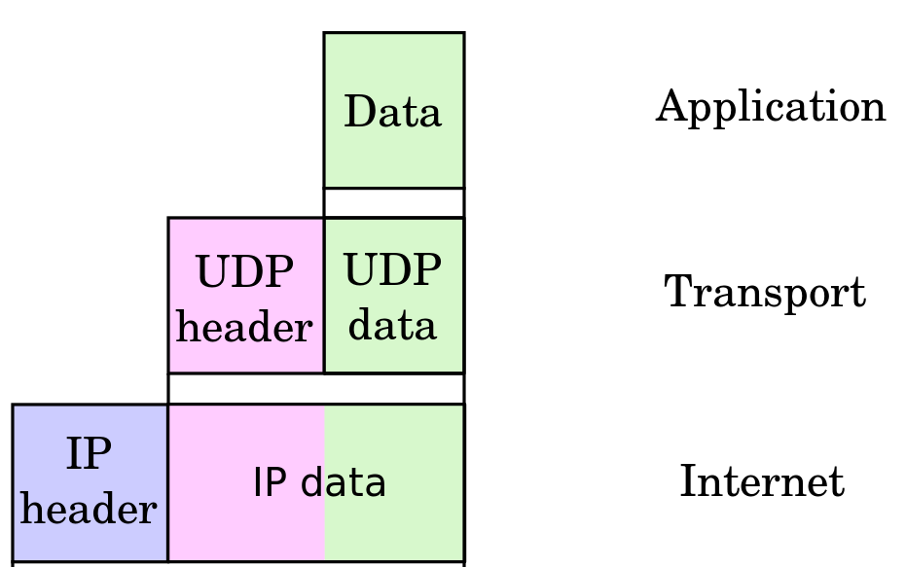
IP Packet structure

Slide 11

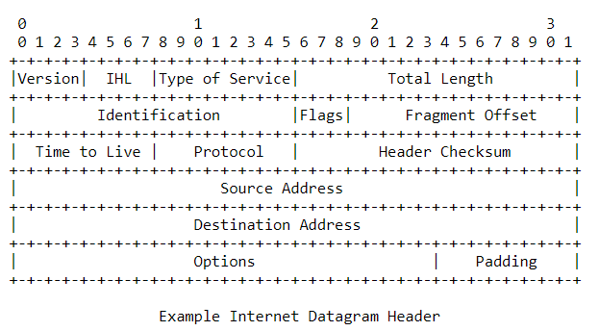
IP Header
Stolen from : https://tools.ietf.org/html/rfc791#section-2.1
I got lazy, sue me!
B.A.T.M.A.N.
Notes:
Version indicates the format of the header (version 4 in our case)
IHL Internet Header Length, length of the header in 32 bit words, and thus pointes to the beginning of the payload
Type of service provides abstract parameters for the quality of service required.
Total length the length of the data gram, in octets (up to 65,535 octets)
Identification ID send by sender to aid in the reconstruction of the packets.
Flags control flags for fragmentation.
Fragment offset indicates where in the original datagram, this fragment belongs.
Time to live indicates the max time this packet is allowed to remain in the internet system. In sec
Header Checksum a check sum on the header only
Source address where the data came from
Destination address where the data is going.
Options optional section. many options relating to the packet
Padding used to ensure that the header ends on a 32 bit boundary.
Protocol specifies the protocol for the next layer of the Model (routing protocols). Like B.A.T.M.A.N! (Better Approach To Mobile Adhoc Networking)

Slide 12
Questions?

